Slide 1
Convolutional Neural Networks II
(Many figures adapted from Stanford CS230, Stanford CS231n, Illinois CS 498 and Berkeley Stat 157)

Slide 2
Outline
CNN Pipeline
CNN Architectures
LeNet-5
AlexNet
VGG Net
Network in Network and 1×1 Convolutions
GoogLeNet and Inception

Slide 3
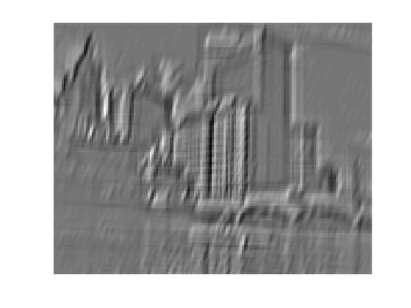
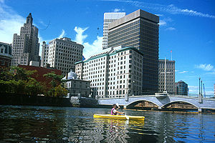
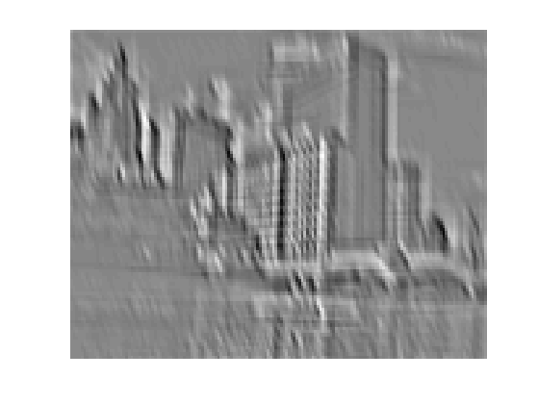
CNN Pipeline (1/4)
Feature maps
Spatial pooling
Non-linearity
Convolution (Learned)
...
Input Image
Input
Feature Map
Source: R. Fergus, Y. LeCun

Slide 4
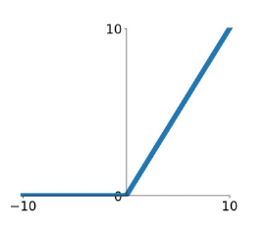
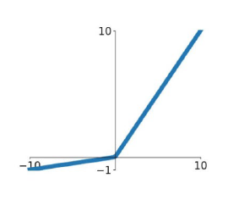
CNN Pipeline (2/4)
Feature maps
ReLu
Spatial pooling
Non-linearity
Convolution (Learned)
LeakyReLu
Input Image
Source: R. Fergus, Y. LeCun
Source: Stanford 231n

Slide 5
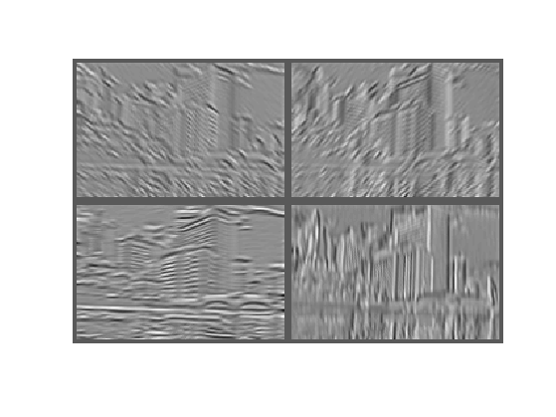
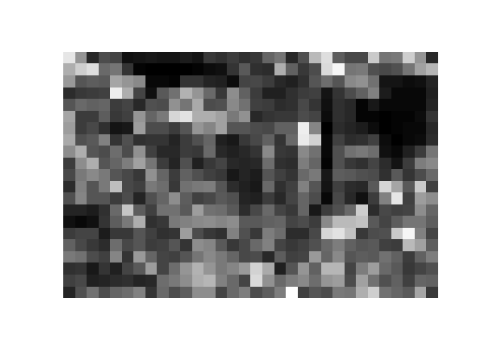
CNN Pipeline (3/4)
Feature maps
Max (or Avg)
Spatial pooling
Non-linearity
Convolution (Learned)
Input Image
Source: R. Fergus, Y. LeCun

Slide 6

CNN Pipeline (4/4)
Softmax layer:

Slide 7
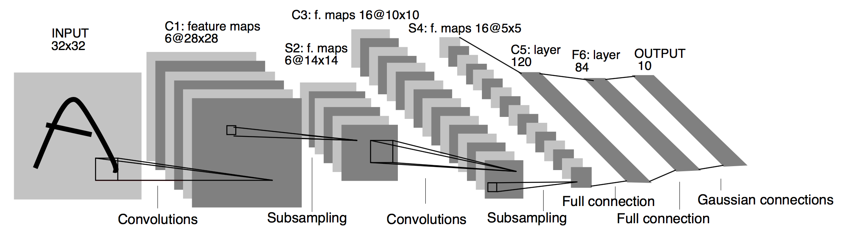
LeNet-5 (1/4)
LeCun et al., 1998. Gradient-based learning applied to document recognition

Slide 8
LeNet-5 (2/4)
The goal of LeNet-5 was to recognize handwritten digits.
Input image: 32×32×1
Grayscale(灰階) image
Thus the number of channels is 1
10 classes

Slide 9
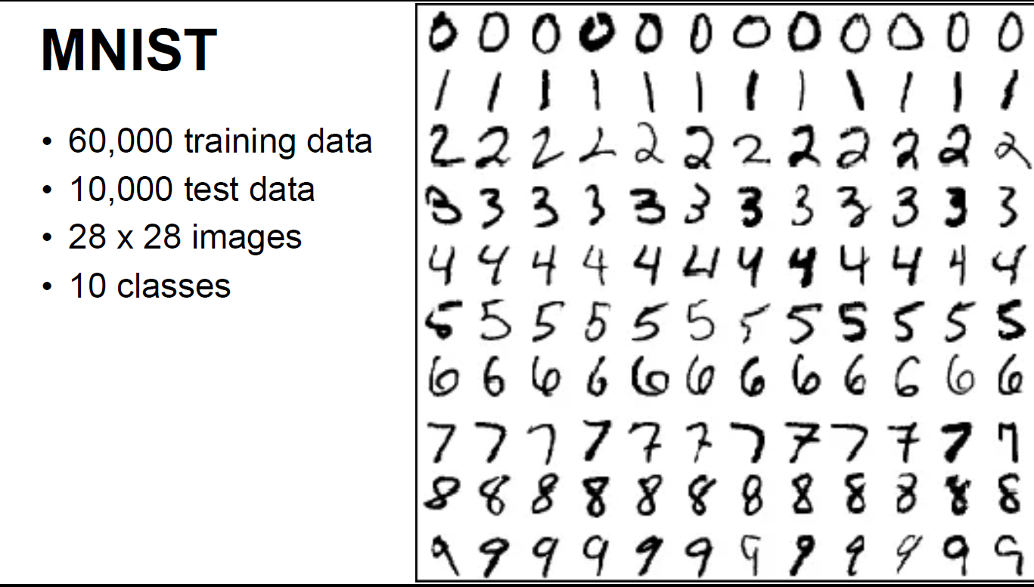
LeNet-5 (3/4)
The MNIST database is a large database of handwritten digits that is commonly used for training various image processing systems.

Slide 10
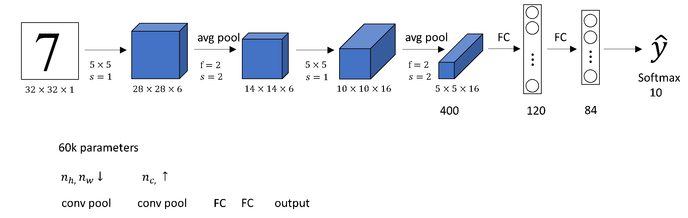
LeNet-5 (4/4)
The architecture of the LeNet−5 neural network leads to a decrease of height and width of volume and to increase the number of channels

Slide 11
Summary: LeNet-5 (1/2)
LeNet-5 is the first (第一個) convolutional neural network.
LeNet-5 consists of one or more convolutional layers followed by a pooling layer and then some fully-connected layers and ends up with an output layer, which is a softmax layer.
⇒ This may be the key feature of deep learning for images since this paper.
The number of channels of LeNet-5 increases.
It goes from 1 to 6 to 16.
It has a small number of parameters – 60,000.
Today we use neural networks that have from 10 million to 100 million parameters.

Slide 12
Summary: LeNet-5 (2/2)
Some other notes on LeNet-5:
At the time, there was no GPU to help with training, and even CPUs were slow.
Back then, people used sigmoid and tanh nonlinearities.
The authors used average(平均) pooling rather than max pooling.

Slide 13
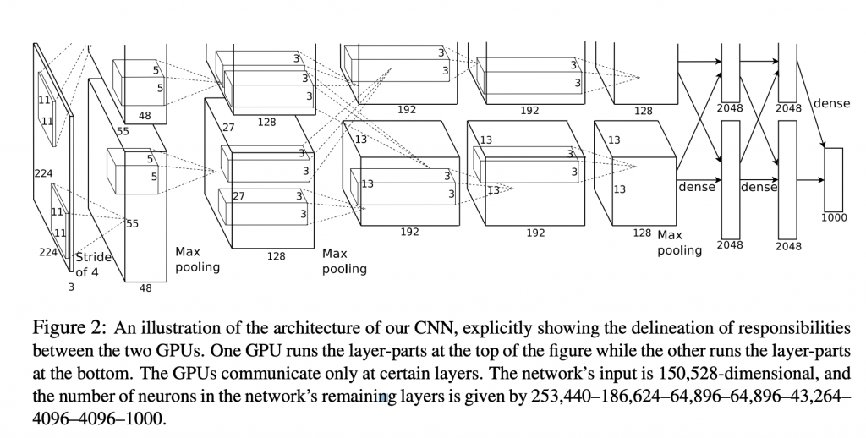
AlexNet (1/4)
Krizhevsky et al., 2012. ImageNet classification with deep convolutional neural networks

Slide 14
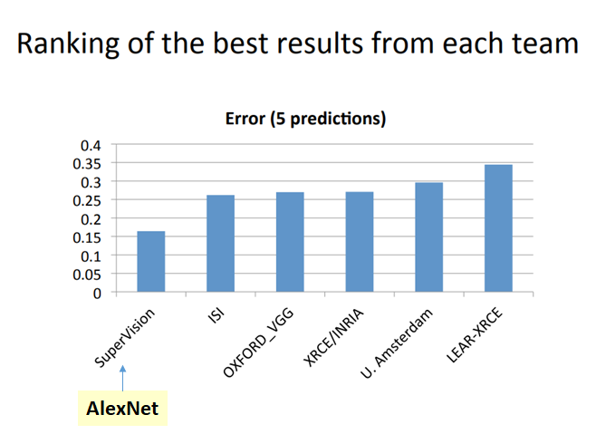
AlexNet (2/4)
AlexNet achieved a top-5 error of 15.3% in the ImageNet 2012 Challenge.
It was 10.8% lower than the second place.

Slide 15
What is the ImageNet Challenge?
~14 million labeled images, 20k classes
Images gathered from Internet
Human labels via Amazon MTurk
ImageNet Large-Scale Visual Recognition Challenge (ILSVRC): 1.2 million training images, 1000 classes
www.image-net.org/challenges/LSVRC/

Slide 16
AlexNet (3/4)
An input to this neural network is 227×227×3.
A color image
3 channels
1000 classes
AlexNet has 8 layers — 5 convolutional and 3 fully-connected.
Three max-pooling layers.
AlexNet was the first to use Rectified Linear Units (ReLUs) as activation functions.(是第一個使用ReLUs的)

Slide 17
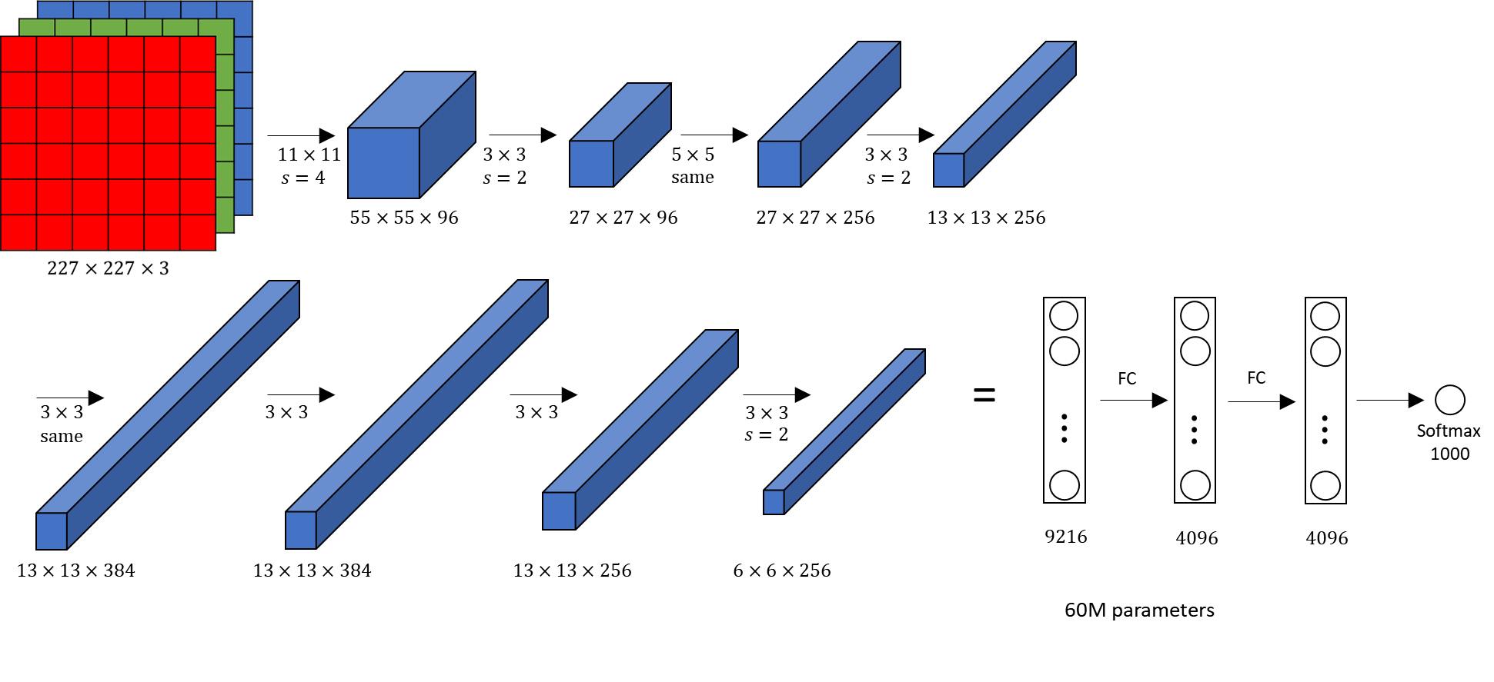
AlexNet (4/4)

Slide 18
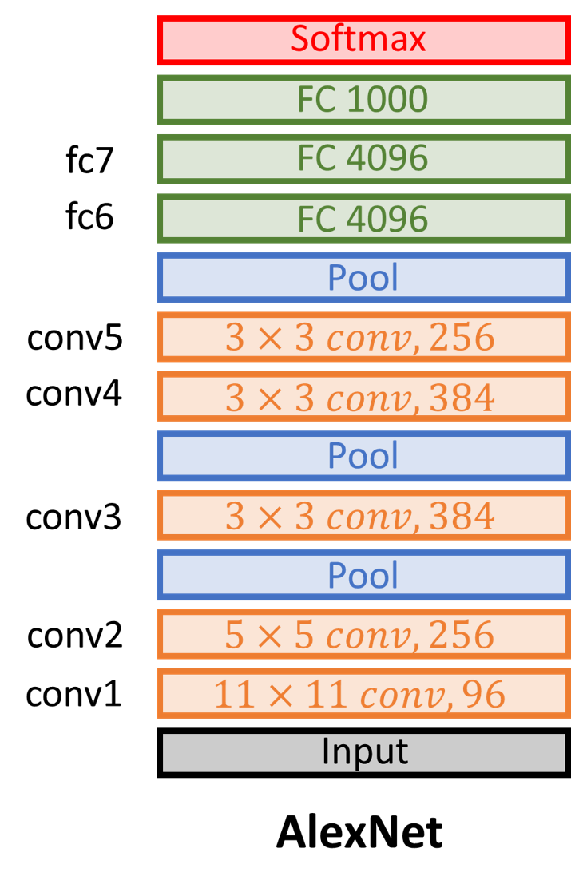
AlexNet VS. LeNet-5 (1/2)
AlexNet is similar to LeNet-5 but much larger.
LeNet-5 has about 60,000 parameters.
AlexNet has about 60 million parameters.
Computationally expensive
⇒ Use GPUs during training

Slide 19
LeNet-5 VS. AlexNet (2/2)
Some other tricks in AlexNet
Change activation function from sigmoid to ReLu
Avoid vanishing gradient 避免梯度消失
Add a dropout layer after two hidden dense layers
Better robustness/regularization
Data augmentation
Better robustness/regularization

Slide 20

VGG 16 (1/4)
VGG16 Architecture
Simonyan & Zisserman 2015. Very deep convolutional networks for large-scale image recognition

Slide 21
VGG 16 (2/4)
VGG Net is invented by VGG (Visual Geometry Group) from the University of Oxford.
VGG Net is the first one to achieve less than 10% error rate for ImageNet competition.

Slide 22
VGG 16 (3/4)
An input to this neural network is 224×224×3.
A color image
3 channels
1000 classes
The VGG 16 network has 16 layers — 13 convolutional and 3 fully-connected.
The 16 in VGG16 refers to it has 16 layers that have weights.

Slide 23
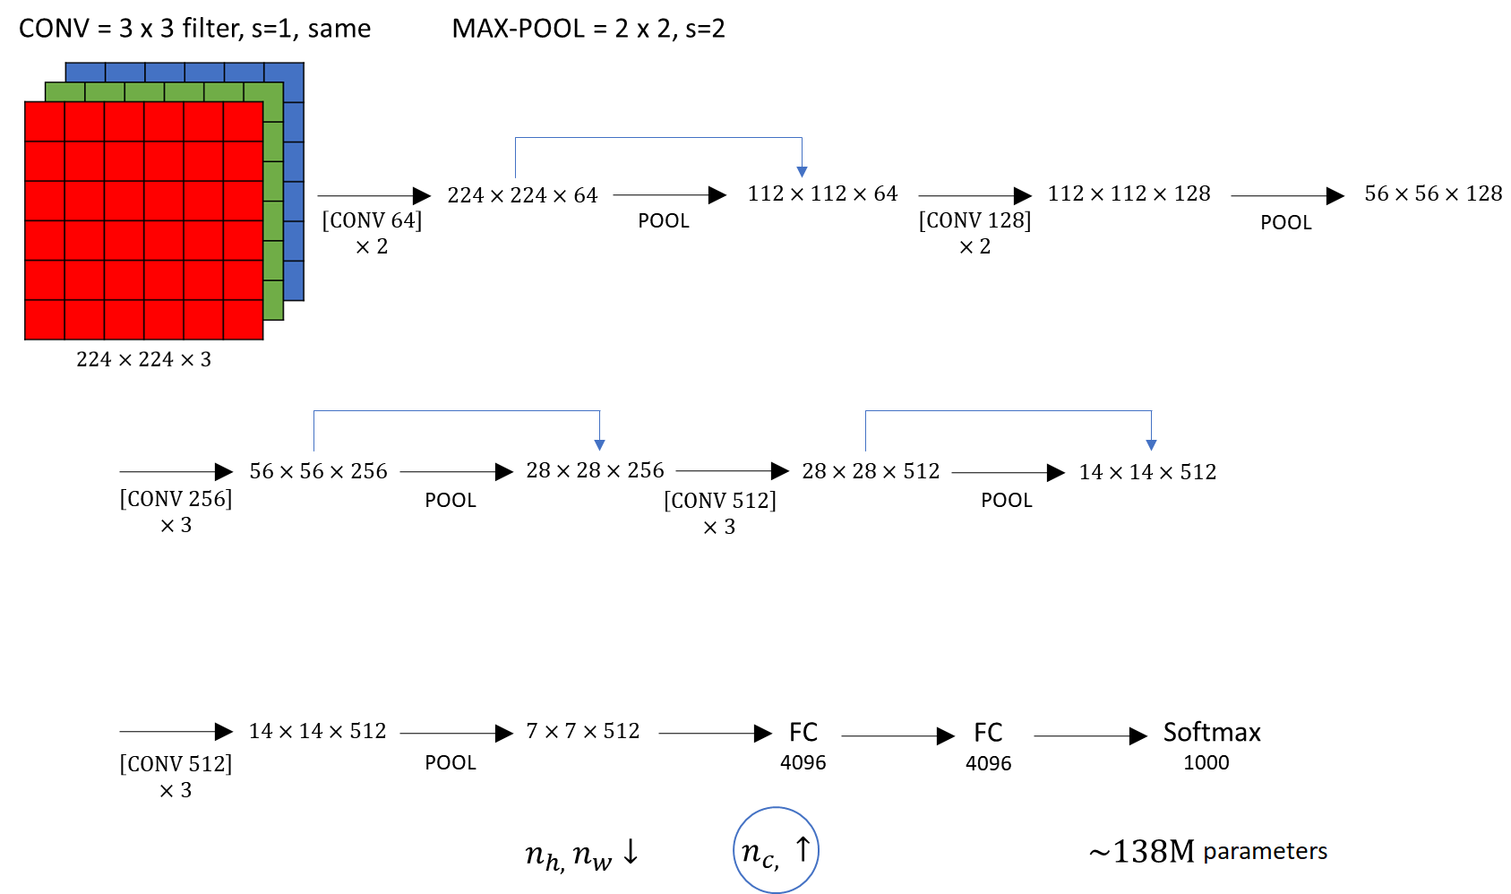
VGG 16 (4/4)

Slide 24
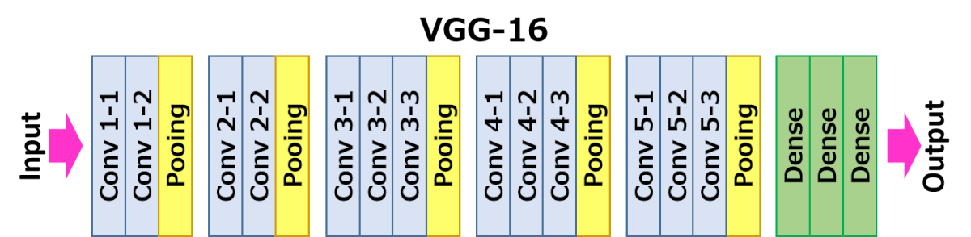
Summary: VGG 16
Compared to the AlexNet network, VGG 16 network has smaller filters but deeper layers.
All convolutional layers are divided into 5 groups and each group is followed by a max-pooling layer.

Slide 25
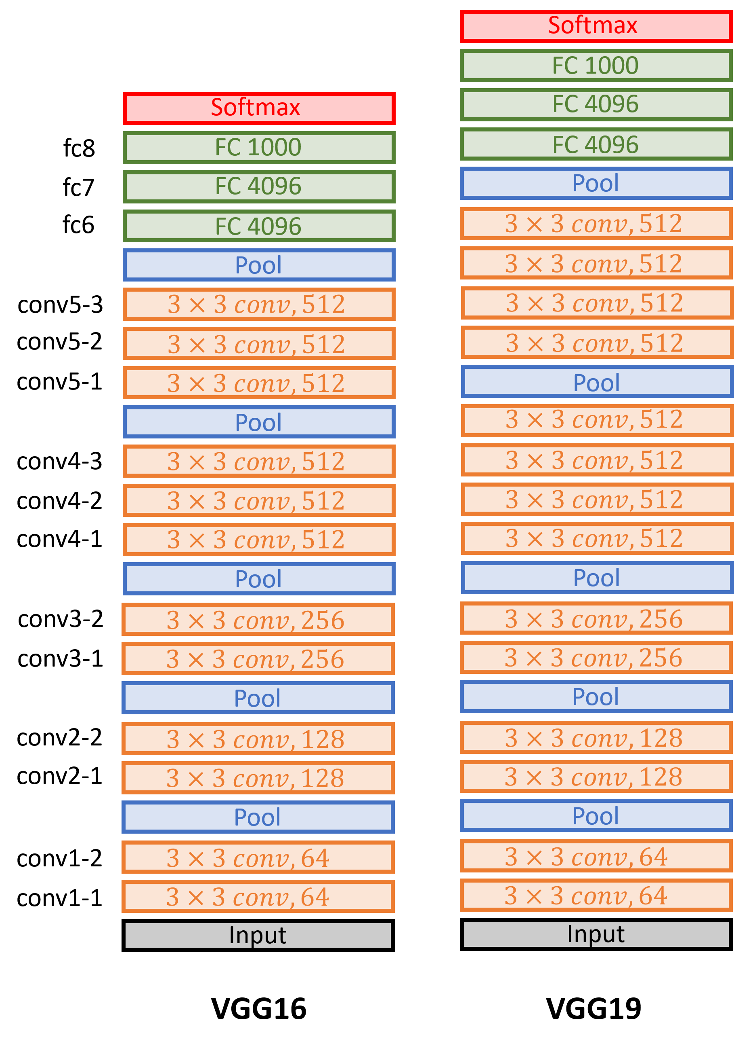
VGG 16 and VGG 19
The VGG Net has two versions, VGG16 and VGG19, corresponding to the number of layers in the network.

Slide 26
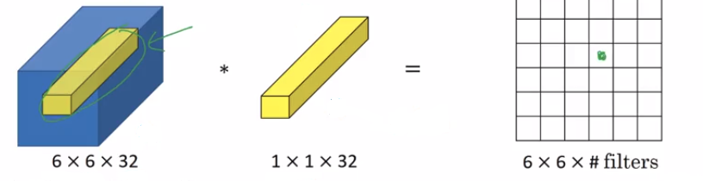
Network in Network and 1×1 Convolutions (1/5)
Network-in-network (NiN) uses 1x1 convolutions to provide more combinational power to the features of a convolutional layers.
Lin et al., 2013. Network in network

Slide 27
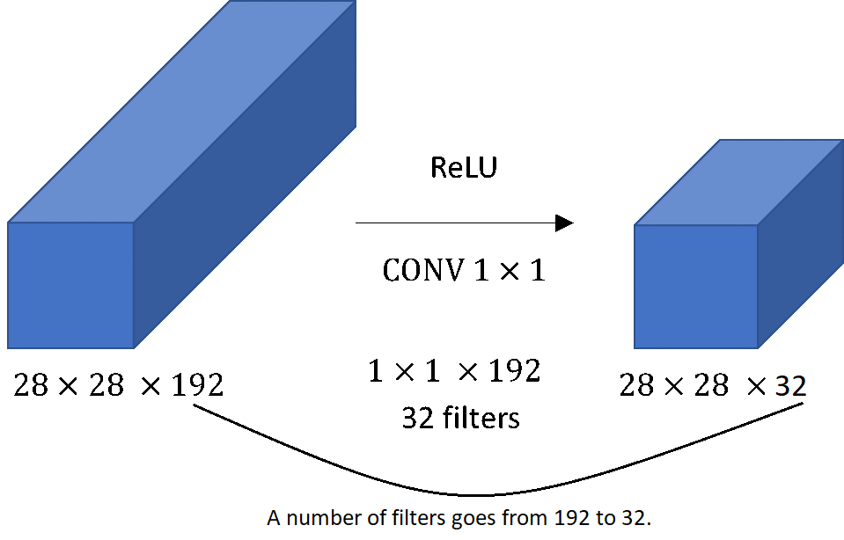
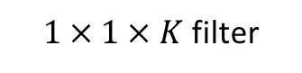
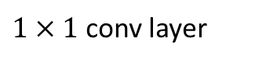
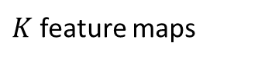
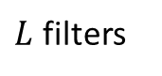
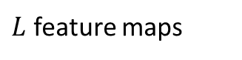
Network in Network and 1×1 Convolutions (2/5)
Example: K = 192, L = 32
$K$ feature maps
$L$ feature maps
$1×1×K$ filter
$L$ filters
$1×1$ conv layer

Slide 28
Network in Network and 1×1 Convolutions (3/5)
Here 1×1 convolutions are used to spatially combine features across features maps after convolution.
So they effectively use very few parameters, shared across all pixels of these features.
One way to think about the 1×1 convolution is that it basically has a fully connected neuron network, and the 1×1 convolution is also called Network in Network.

Slide 29
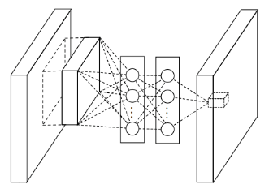
Network in Network and 1×1 Convolutions (4/5)
“network in network”
M. Lin, Q. Chen, and S. Yan, Network in network, ICLR 2014

Slide 30
Network in Network and 1×1 Convolutions (5/5)
Though the Network in Network architecture is not used widely, this idea of a 1×1 convolution has influenced many other neural network architectures, including the inception network.

Slide 31
GoogLeNet and Inception (1/7)
GoogLeNet devised a sparse connection between nodes, called inception modules.
It also utilized filters of different sizes to capture details at varied scales(5×5, 3×3, 1×1).

Slide 32
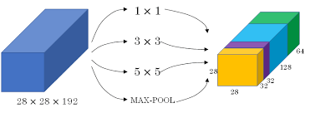
GoogLeNet and Inception (2/7)
Motivation for inception network

Slide 33
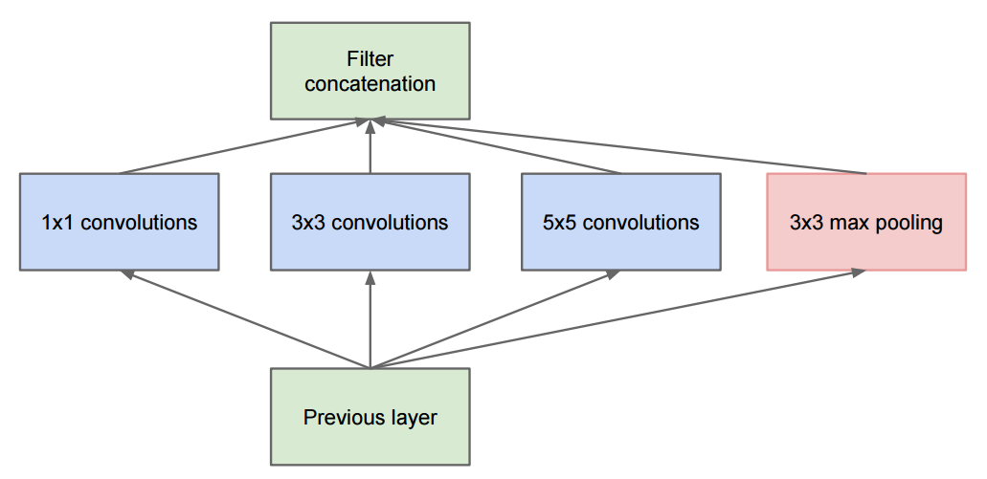
GoogLeNet and Inception (3/7)
The Inception Module
Parallel paths with different receptive field sizes and operations are meant to capture sparse patterns of correlations in the stack of feature maps
C. Szegedy et al., Going deeper with convolutions, CVPR 2015

Slide 34
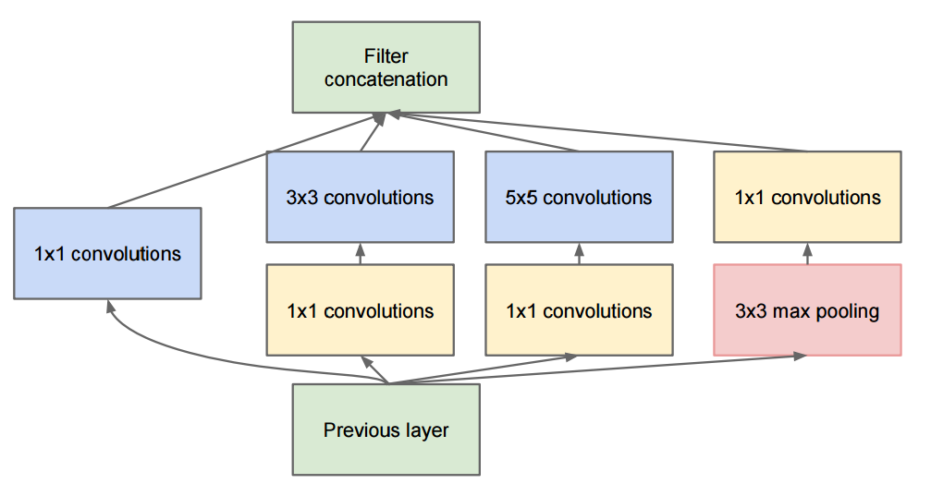
GoogLeNet and Inception (4/7)
The Inception Module
Use 1x1 convolutions for dimensionality reduction before expensive convolutions
C. Szegedy et al., Going deeper with convolutions, CVPR 2015

Slide 35
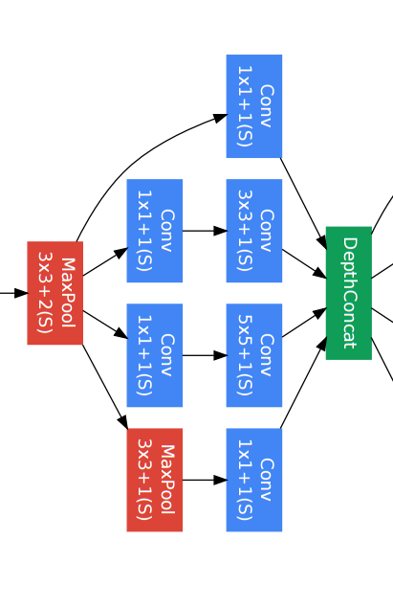
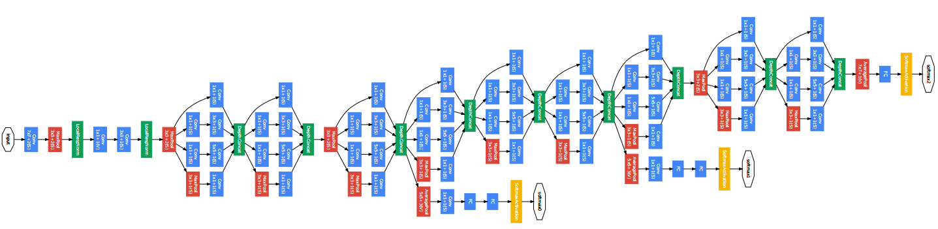
GoogLeNet and Inception (5/7)
Inception module
C. Szegedy et al., Going deeper with convolutions, CVPR 2015

Slide 36
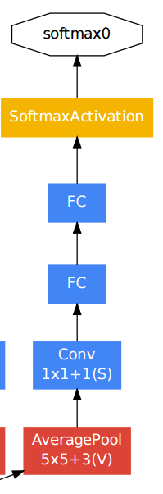
GoogLeNet and Inception (6/7)
Auxiliary classifier
C. Szegedy et al., Going deeper with convolutions, CVPR 2015

Slide 37
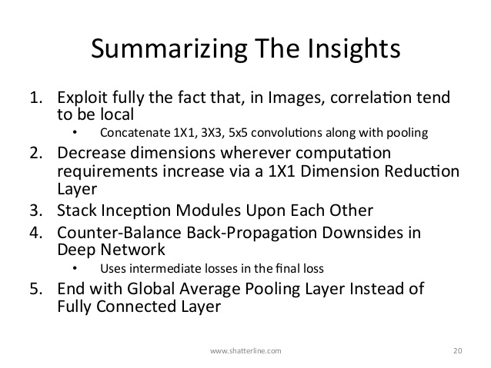
GoogLeNet and Inception (7/7)

Slide 38
References and Resources
Y. LeCun, L. Bottou, Y. Bengio, and P. Haffner, Gradient-based learning applied to document recognition, Proc. IEEE 86(11): 2278–2324, 1998.
A. Krizhevsky, I. Sutskever, and G. Hinton, ImageNet Classification with Deep Convolutional Neural Networks, NIPS 2012
M. Zeiler and R. Fergus, Visualizing and Understanding Convolutional Networks, ECCV 2014
K. Simonyan and A. Zisserman, Very Deep Convolutional Networks for Large-Scale Image Recognition, ICLR 2015
M. Lin, Q. Chen, and S. Yan, Network in network, ICLR 2014
C. Szegedy et al., Going deeper with convolutions, CVPR 2015
Stanford CS230: Deep Learning
Stanford CS231n: Convolutional Neural Networks for Visual Recognition
Illinois CS 498: Introduction to Deep Learning
Berkeley Stat 157: Introduction to Deep Learning
https://towardsdatascience.com/neural-network-architectures-156e5bad51ba

